Slide 1
Intro to TypeScript
Spencer Schneidenbach

Slide 2
What is TypeScript?
A superset of JavaScript created by Microsoft
Transpiled into JavaScript
Focuses on:
Application-scale language which adds type safety
Modern features
ES6 – classes, arrow functions
ES7 – async/await
ES?

Slide 3
Main reason why TypeScript is great
“TypeScript doesn’t try to NOT be JavaScript – it just tries to make JavaScript better”
–Spencer

Slide 4
Types
Everything derives from object!
number
string
boolean
Array

Slide 5
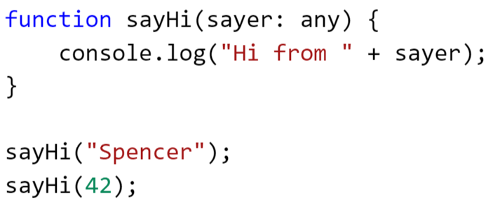
Types, cont’d
“any” type
Means anything goes

Slide 6
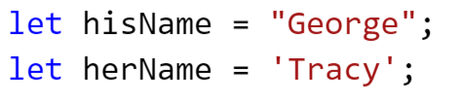
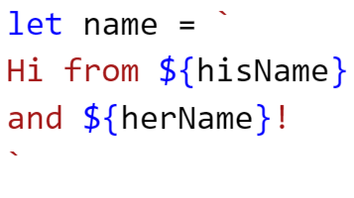
Quick note on strings
You can still declare strings using double quote or single quote:
But you can also use template strings!
Multiline AND interpolation… just use backticks!

Slide 7
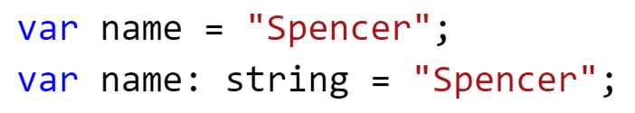

Variables
Largely the same as JavaScript
TypeScript adds type hints
TypeScript is strongly typed

Slide 8
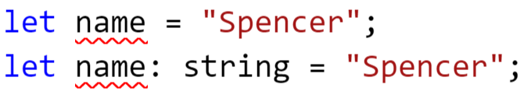
Variables, cont’d
Notice something strange?
Yes, it’s declared twice – and that’s totally valid
Use let or const instead – it’s safer

Slide 9
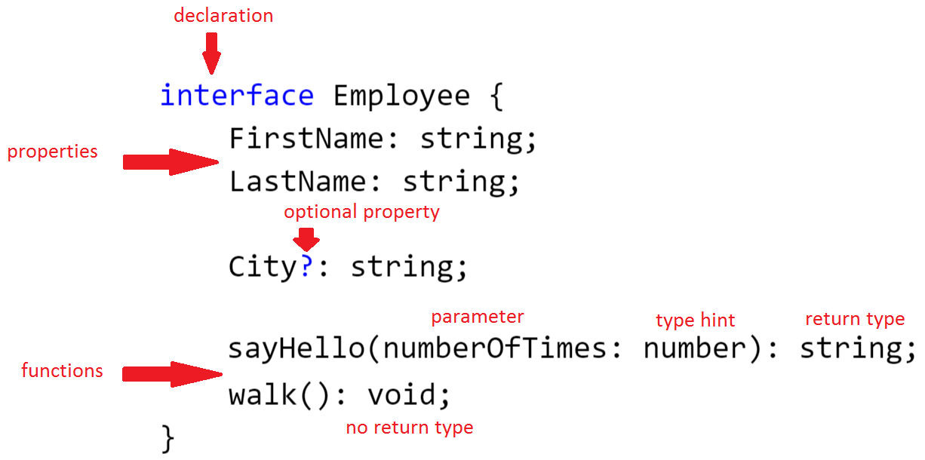
Interfaces
Classes without functionality – just like C#

Slide 10
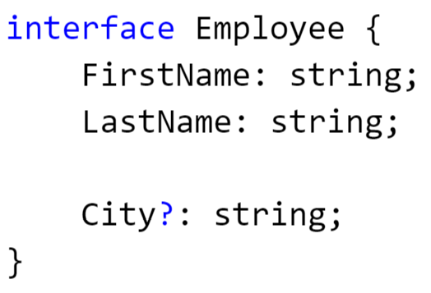
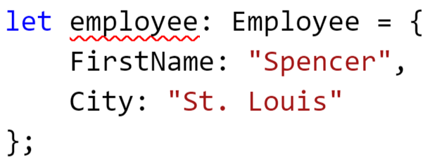
Interfaces, cont’d
Won’t let you compile with this type hint if you don’t fulfill the entire contract!

Slide 11
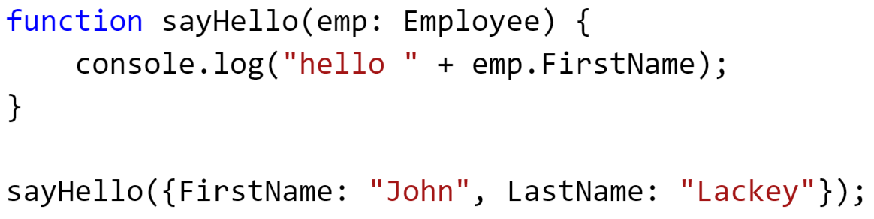
More interfaces
Duck typing: “If it walks like a duck and quacks like a duck… it’s a duck”
This is valid! And good! Respects JavaScript while adding safety

Slide 12
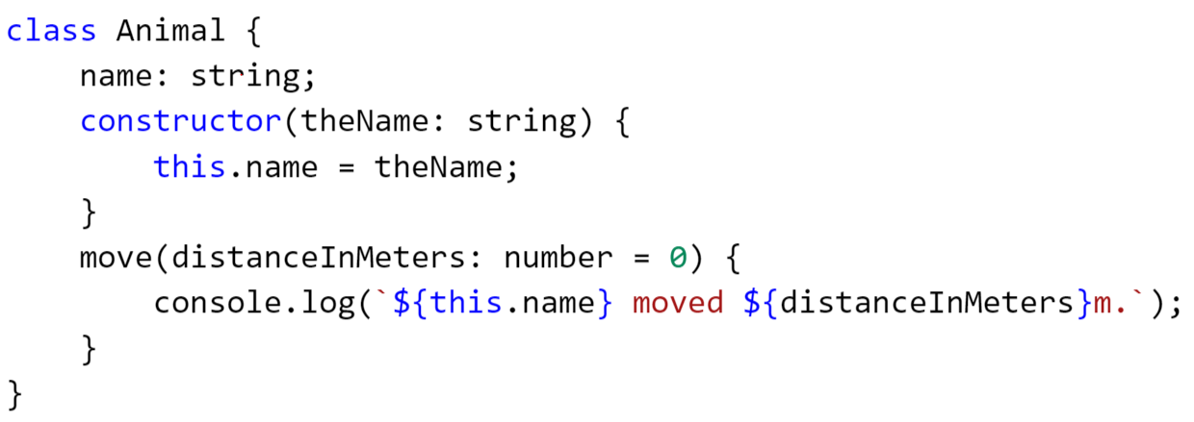
Classes
Classes can define behaviors AND properties
Notes:
Source: http://www.typescriptlang.org/docs/handbook/classes.html

Slide 13
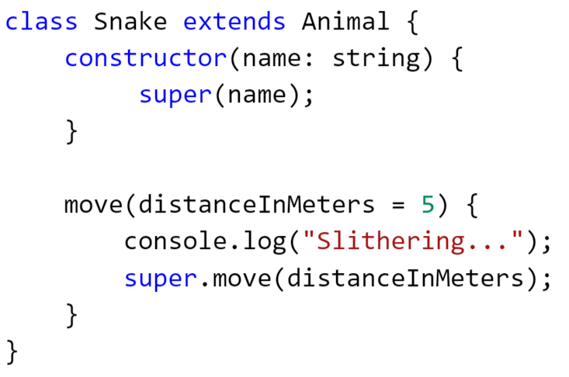
Classes, cont’d
Inheritance is a thing
Notes:
Source: http://www.typescriptlang.org/docs/handbook/classes.html

Slide 14
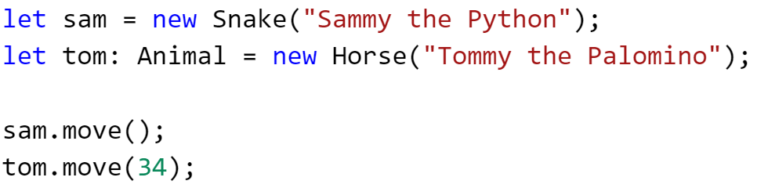
Using classes
Notes:
Source: http://www.typescriptlang.org/docs/handbook/classes.html

Slide 15
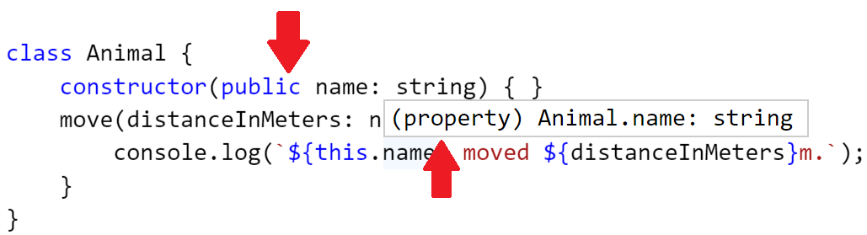
Constructor/property shorthand
Adding an accessibility modifier to a parameter in the constructor automatically converts it to a property

Slide 16
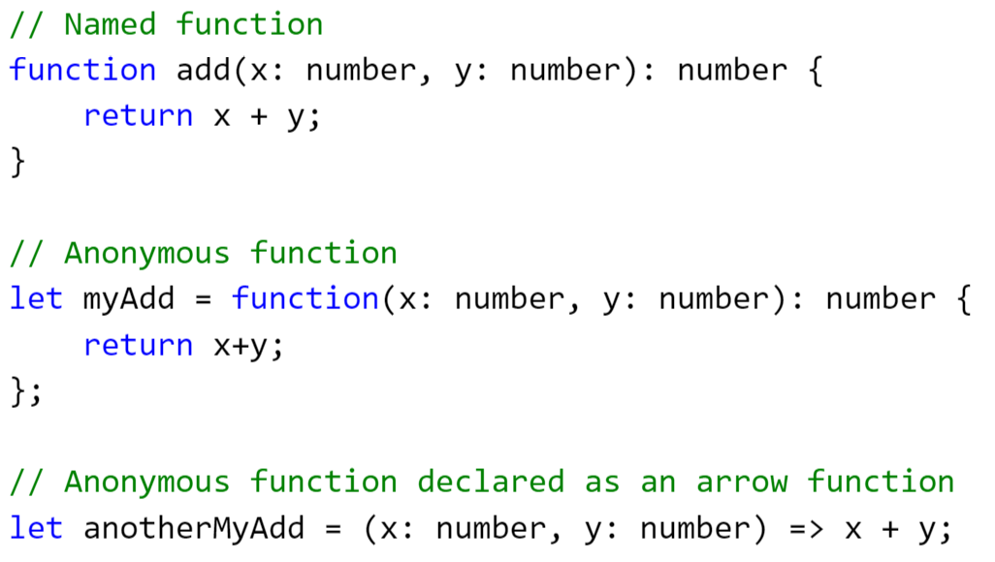
Functions
Perform actions

Slide 17
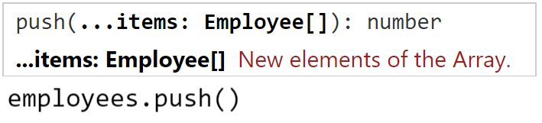
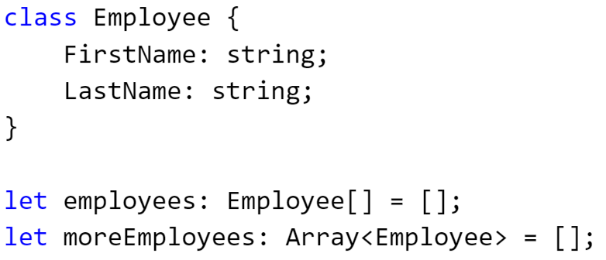
Generics
Like C# and VB.NET generics
Most common generic: Array type

Slide 18
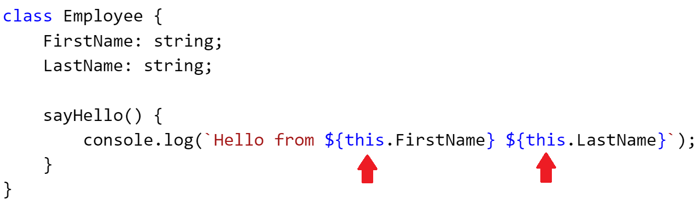
this
Lots of power, lots of heartache, as this can be changed function by function
Our main use for it: know that you need to use this to access variables in class scope

Slide 19
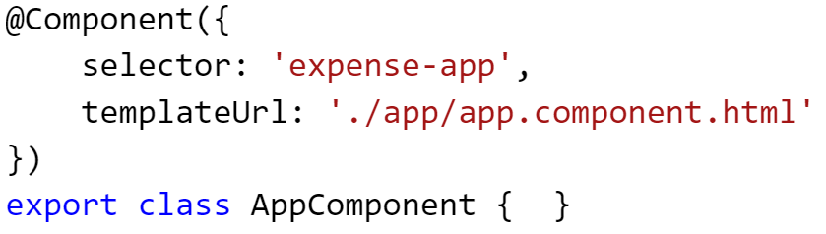
Decorators
Basically, attributes in C#/VB.NET
Considered experimental feature – can only be turned on with compiler option

Slide 20
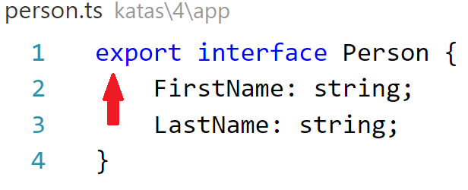
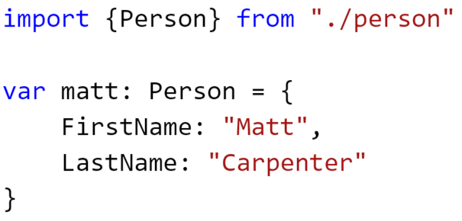
import/export
Like using statements in C#/VB.NET
import statements allow us to get code from other TypeScript declarations
export simply means public

Slide 21
Truthy/falsy
TypeScript has null and undefined, like JavaScript
And they are NOT the same thing!
You don’t check for null, you check for truthiness/falsiness
Falsy values:
false
null
undefined
0
“” (empty string)
NaN (which means not a number)

